Slide 1
Data Visualization Project
Teodorescu Andrei
Eugen Mihail
505 BDTS

Slide 2
Introduction
The chosen dataset contains the top 250 most expensive football transfers made between season 2000-2001 until season 2018-2019. The dataset was created on 1 August 2018 and this was uploaded to kaggle.com by a student from Duke University, United States.
Here is the link to the dataset:
https://www.kaggle.com/vardan95ghazaryan/top-250-football-transfers-from-2000-to-2018

Slide 3

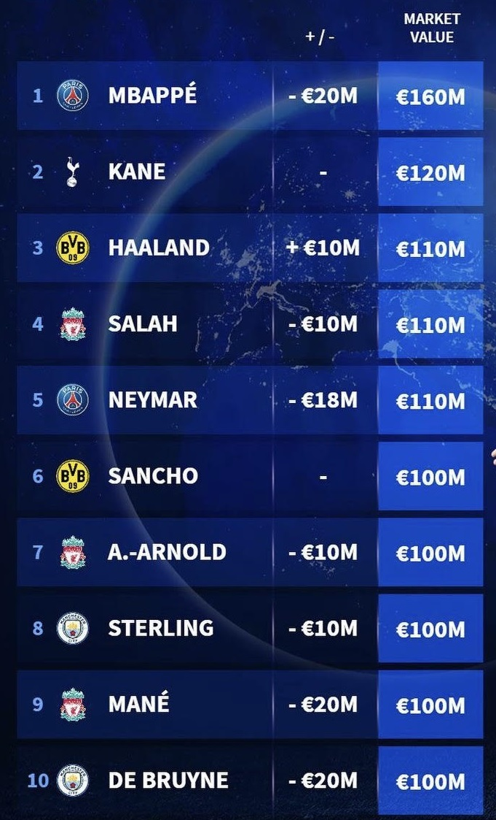
Motivation
We chose this dataset because we are both passionate about this football transfer industry and because at first glance it seemed like a dataset from which we could draw interesting conclusions about this topic.

Slide 4
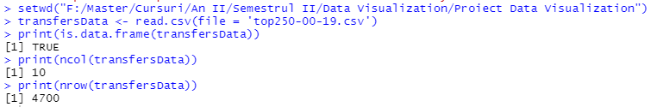
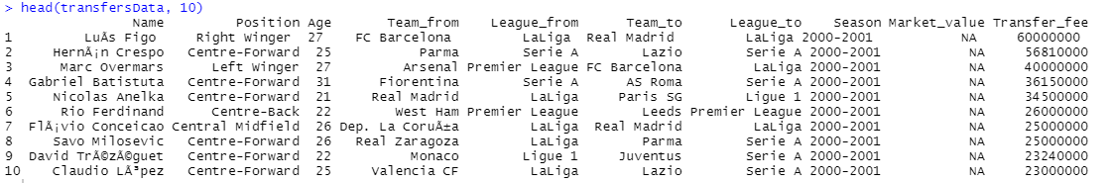
Preparation
We started the project by loading the data set and analyzing it in detail.

Slide 5
Starting point
We started our journey from the most expensive transfer that was made throughout the nine seasons and it was nobody else than Neymar when he left Barcelona for PSG.

Slide 6
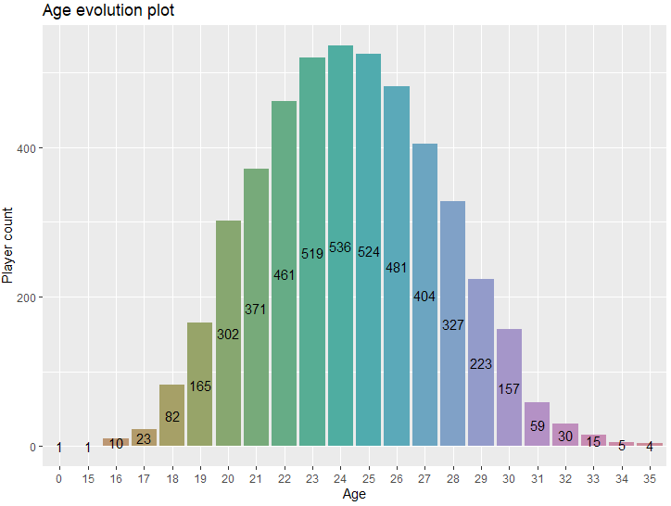
Beginning of interpretation
It can be seen that the age of a player greatly influences the chances of him being included in a transfer. We can consider that the age of 25 is the moment when a player can reach his peak of form. As the player gets older, the chances of him being transferred diminish, because 33 is the age until which most players play at a professional level.

Slide 7
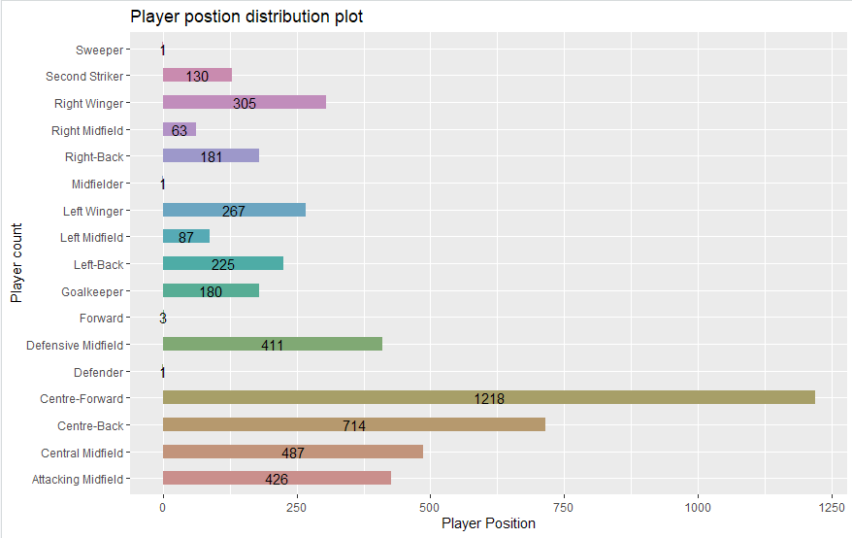
Player position distribution
This plot is very interesting, at first sight we can see that the most sought after players are those who play in central positions: Centre-Forward, Centre-Back, Centre-Midfield and those who position themselves on the flanks have a lower number of transfers.

Slide 8
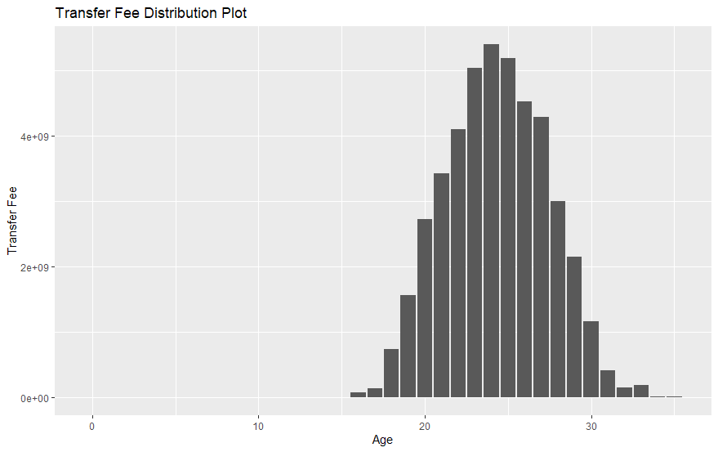
Transfer value distribution
This plot comes somewhat in addition to the one about age distribution. The same conclusion can be drawn, as a player approaches the age of 24-25 his value increases, then begins to gradually decrease.

Slide 9
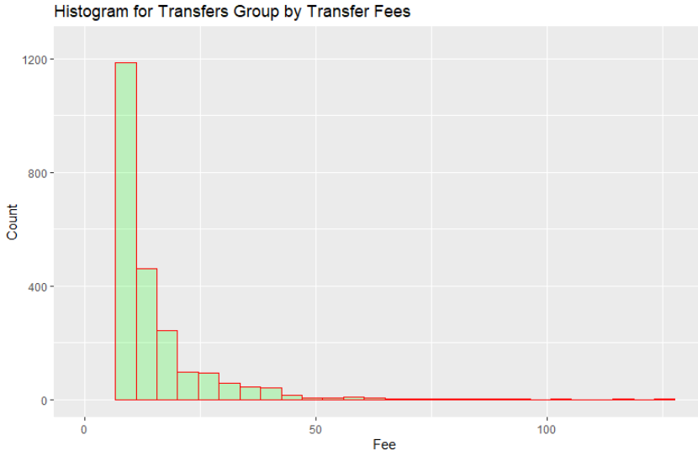
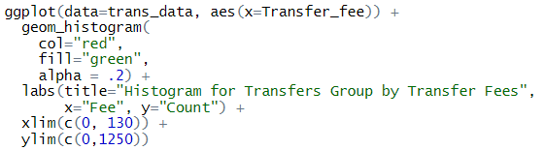
Histogram of transfers by Transfer Fees
As can be seen in this plot, most transfers are made for small amounts. We have around 3250 transfers made under value of 10 million and cases where transfers are around 50 million or more are very rare.
This scenarios

Slide 10
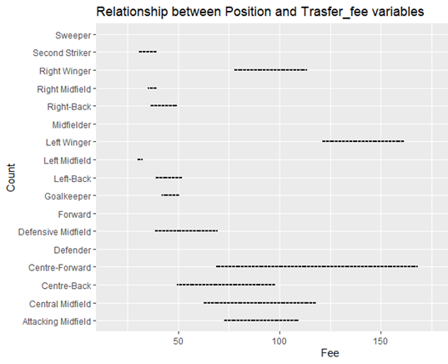

Distribution of Transfer Fee and Position
Even we had a lot of records removed from the dataset because the plot function said those records do not have finite values, we can interpretate this plot by saying that the Centra-Forward players have the widest rate regarding the Transfer Fee.
Another interesting thing it is defined by the transfers made for Left Winger players. Even they are playing in the defensive compartment, the transfer free rate is quite high.

Slide 11
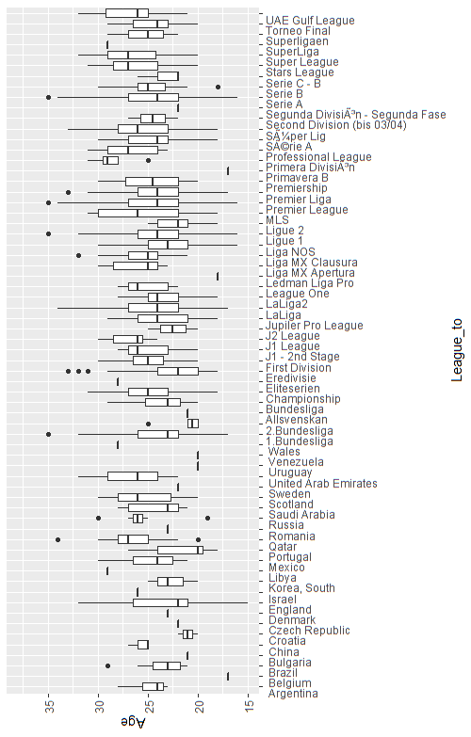
Distribution transfers by league and age
In this plot we can see examples of leagues that have all kind of distributions:
Normal distribution like Second Division, Premier Liga, First Division, Championship or Croatia;
Positive Skew like Super League, Stars League, Serie B, LaLiga2, or Quatar;
Negative Skew like UAE Gulf League, LaLiga, 1.Bundesliga, Portugal, Premier League or Israel.

Slide 12
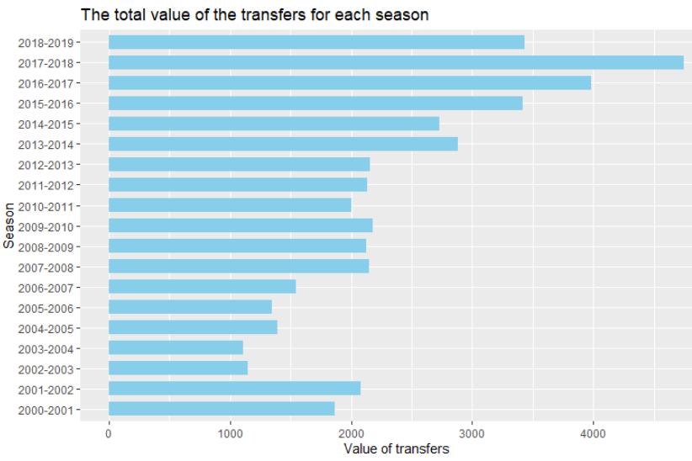
The total value of transfers per season
Here, we can easily observe the upward trend of the total amount of transfers, starting with season 2002-2003 up to season 2017-2018. As a remark, this is the season when we had the biggest transfer of all times (Neymar Jr. 222 mil.).
If we compare the transfers made in the 2012-2013 season with those of 2017-2018 we notice the enormous difference (more than double) between the two seasons that were only 5 years away from each other.

Slide 13
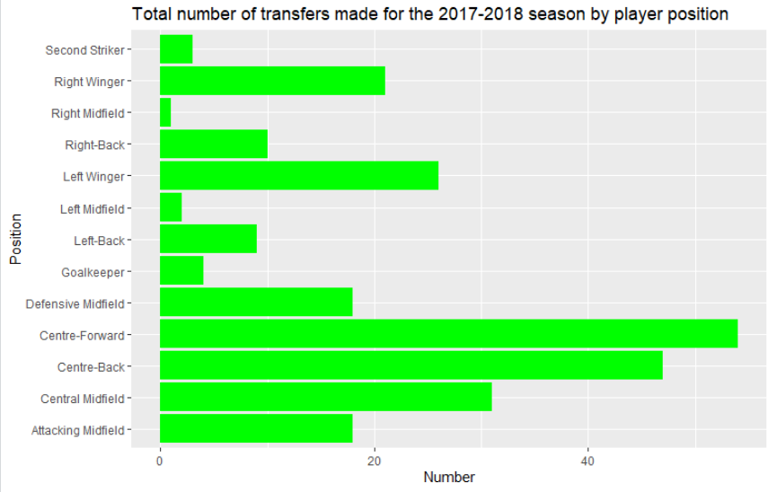
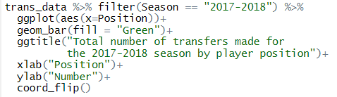
Interpretation of positions for the players sold in the most valuable season (2017-2018)
As can be seen in this plot, the middle compartment has the most players sold in 2017-2018 season.
Given that this is the most valuable season, we can imagine that these transfers have played an important role in achieving this high value.

Slide 14
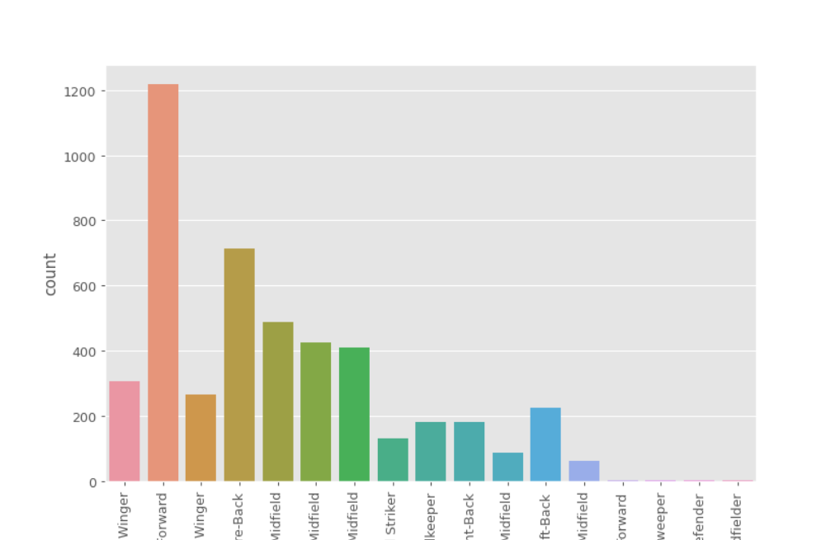
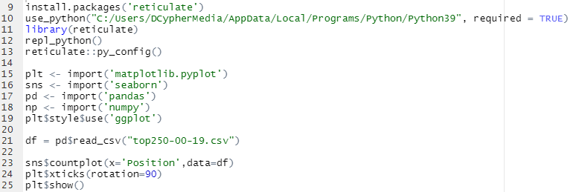
Reticulate library
In developing this project we tried to use the relicate library in R Studio, but we were not very successful. But still these are our results.

Slide 15
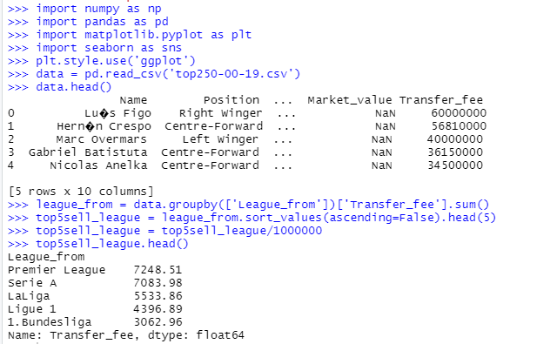
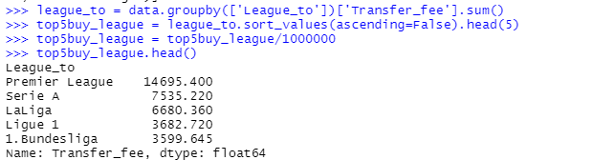
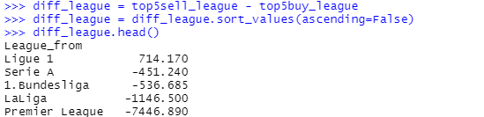
Top 5 of Buying Leagues
Top 5 of Selling Leagues
Top 5 of Profitable Leagues

Slide 16
Conclusion
After the development of this project we can say that we retained basic knowledge in manipulating and visualizing a dataset. At the same time, we would have liked to succeed more in the part where we tried to use the Relicate library.

Slide 17
Thank you for your attention!
Have a great day!

